Slide 1

EXECUTIVE READOUT · CUSTOMER SHOPPING BEHAVIOR · DASHBOARD SUMMARY
Customer shopping generates $233K
across 3,900 customers
PRESENTER TALK TRACK
This executive readout summarizes customer shopping behavior from the dashboard. We have a useful baseline: roughly $233,000 in sales across 3,900 customers. The opportunity is to turn these patterns into testable decisions.

Slide 2
BASELINE · DASHBOARD SNAPSHOT
$233,081 in revenue; the average sale is $59.76
TOTAL REVENUE
AVERAGE SALE
AVERAGE RATING
$233,081
$59.76
3.75
Across 3,900 customers
CUSTOMERS
AVERAGE PREVIOUS-PURCHASE MEASURE
3,900
25.35
A useful business baseline—not proof of what caused buying behavior.
PRESENTER TALK TRACK
We have a useful baseline: roughly $233,000 in sales across 3,900 customers. The average sale is just under $60 and the overall rating is 3.75. The opportunity now is to turn these patterns into testable decisions.
CUSTOMER SHOPPING BEHAVIOR
02

Slide 3
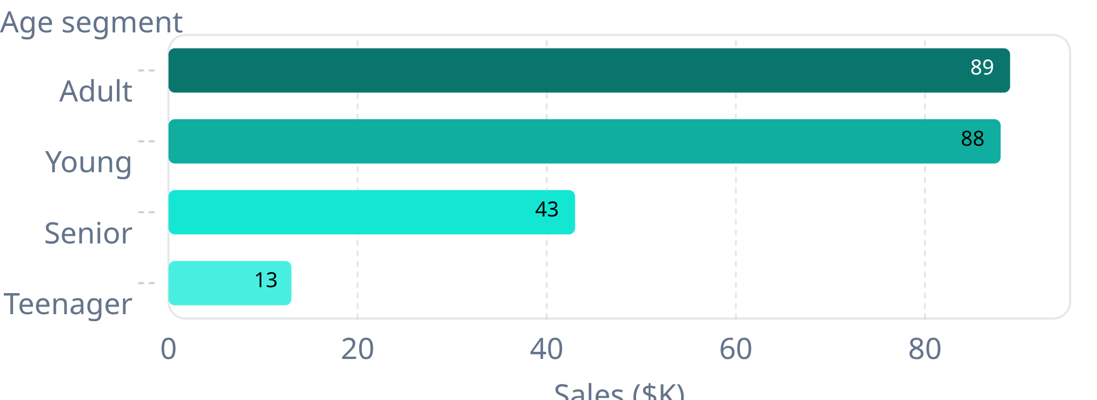
REVENUE MIX · CUSTOMER SEGMENTS
Adults and younger shoppers contribute nearly equal sales
MALE CUSTOMERS
$158K · 67.74%
FEMALE CUSTOMERS
$75K · 32.26%
Revenue totals show mix, not normalized segment value per person.
PRESENTER TALK TRACK
Adults and younger shoppers are almost even in total sales, while senior and teen sales are smaller. Male customers account for a larger share of revenue in this dataset. These totals help us see mix; they don’t tell us which group is most valuable per customer.
CUSTOMER SHOPPING BEHAVIOR
03

Slide 4
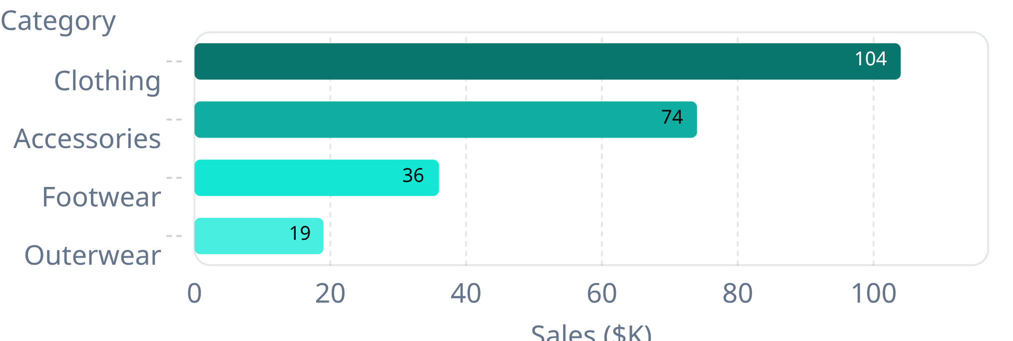
REVENUE MIX · PRODUCT
Clothing leads category sales, with accessories second
Sales by category
Top five products by sales
PRODUCT | SALES
Blouse | $10,410
Shirt | $10,332
Dress | $10,320
Pants | $10,090
Jewelry | $10,010
CATEGORY SALES · APPROXIMATE $K
Use the category mix to prioritize a deeper margin and inventory review; sales alone are not profitability.
PRESENTER TALK TRACK
Clothing is the largest sales category at about $104,000, with accessories next at $74,000. The top products are closely grouped around $10,000 each. I’d use this as a starting point for a margin and availability review, not as a profitability ranking.
CUSTOMER SHOPPING BEHAVIOR
04

Slide 5
REVENUE MIX · PURCHASE CADENCE
Quarterly and fortnightly buyers account for the most sales
QUARTERLY
FORTNIGHTLY
ANNUAL · MONTHLY · WEEKLY
$68,859
$65,207
About $32K–$34K each
Each cadence group contributes within this range.
1,147 customers
1,089 customers
Sales and customer counts move together; the dashboard does not establish which cadence causes higher spend.
PRESENTER TALK TRACK
Quarterly and fortnightly groups are the largest by both customer count and sales. The remaining cadence groups are smaller and fairly close to one another. This points to where the current volume sits, but not yet to a campaign that would change purchase frequency.
CUSTOMER SHOPPING BEHAVIOR
05

Slide 6
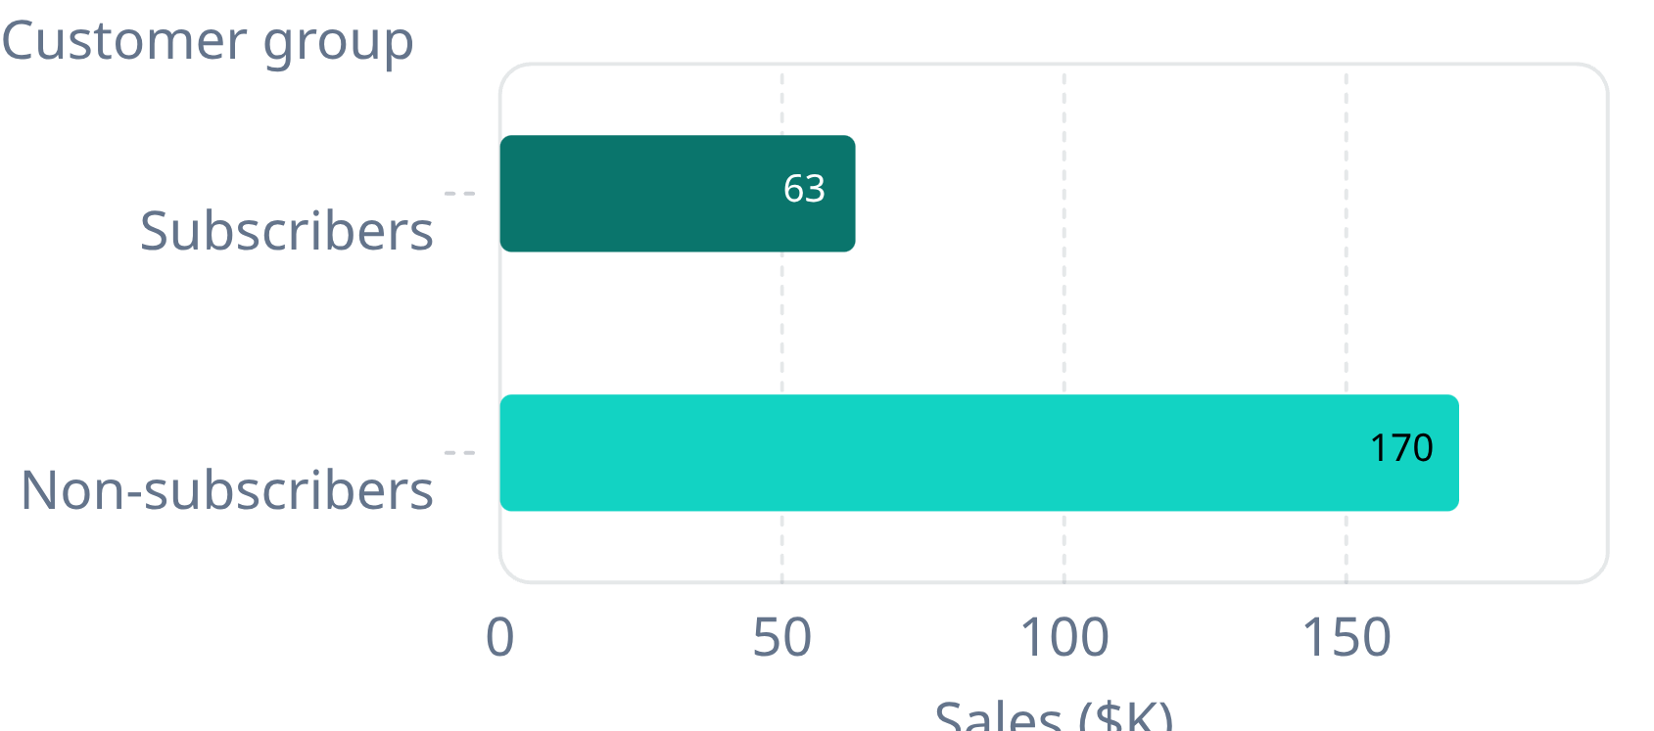
REVENUE MIX · SUBSCRIPTION
Subscribers contribute less total sales, not less per-customer sales
TOTAL SALES · APPROXIMATE $K
REVENUE PER CUSTOMER · CALCULATED FROM MATRIX
Subscribers
Non-subscribers
1,053 customers
2,847 customers
Roughly $59–$60
Roughly $59–$60
Subscription is not shown as a spend lift.
SUBSCRIBERS · 26.88% OF SALES / NON-SUBSCRIBERS · 73.12%
PRESENTER TALK TRACK
Non-subscribers account for more total sales because they are the larger group. When we divide each group’s sales by its customer count, the result is roughly $60 in both cases. The dashboard does not show that subscription itself increases spend.
CUSTOMER SHOPPING BEHAVIOR
06

Slide 7
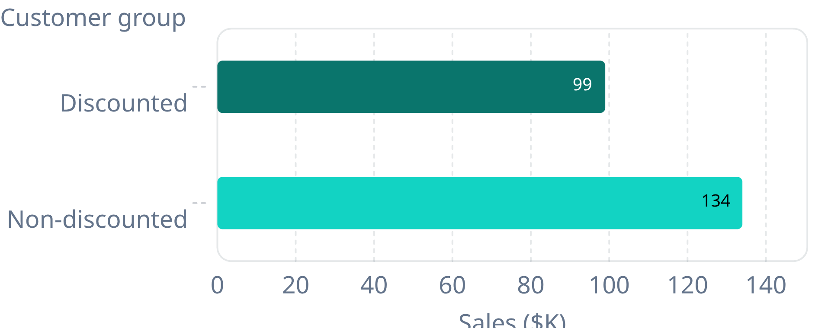
REVENUE MIX · DISCOUNTS
Discounts touch 43% of customers, but lift is unproven
TOTAL SALES · APPROXIMATE $K
DISCOUNTED
1.68K
Customers · 42.6% of sales
NON-DISCOUNTED
2.22K
Customers · 57.35% of sales
These are group totals. The comparison does not isolate incremental spend caused by a discount.
PRESENTER TALK TRACK
Discounts are applied to about 43 percent of customers. The non-discounted group generates more total sales, but it is also larger. Before changing the offer, we should compare average basket and margin across comparable customers to measure incremental lift.
CUSTOMER SHOPPING BEHAVIOR
07

Slide 8
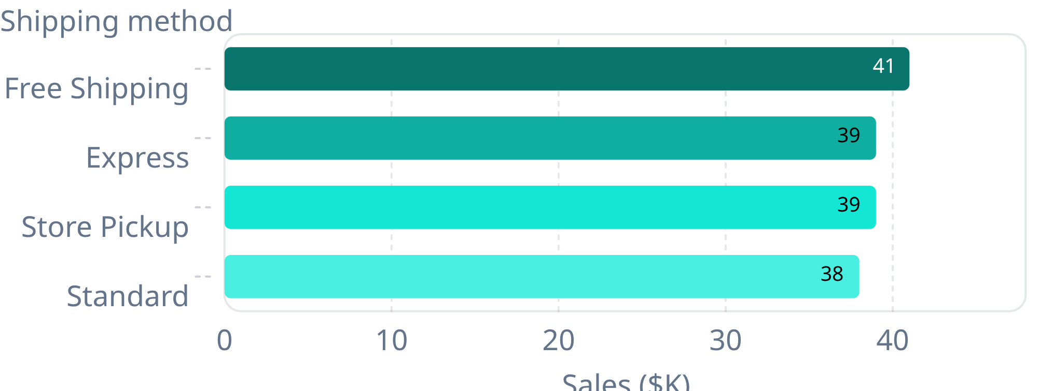
CUSTOMER CHOICES · SHIPPING & PAYMENT
Shipping and payment choices are spread across options
PAYMENT COUNTS
612–677 customers
Bank transfers: 612 · Credit cards: 677. PayPal and cash are close behind.
RATING
3.75 overall
A rating breakdown by shipping method is not visible in the report.
PRESENTER TALK TRACK
No shipping option dominates sales, and payment preferences are distributed across the available methods. The dashboard reports an overall rating, but not enough detail here to connect ratings to shipping. I would avoid changing fulfillment based on this view alone.
CUSTOMER SHOPPING BEHAVIOR
08

Slide 9




NEXT · VALIDATE BEFORE REALLOCATING SPEND
Use this baseline to test four decisions before reallocating spend
Discount lift
Subscription
Measure discount lift against comparable purchases and gross margin.
Test whether subscription changes retention or purchase frequency, not just total sales.
Product performance
State and season
Join product sales to ratings and margin to identify high-volume, low-satisfaction items.
Export readable state and season breakdowns before making geographic or seasonal allocation decisions.
PRESENTER TALK TRACK
The dashboard gives us a clear picture of today’s mix. My recommendation is to validate the levers before shifting investment: measure discount incrementality, test subscription against frequency and retention, connect sales with ratings and margin, and confirm the state-level picture in a detailed export.
CUSTOMER SHOPPING BEHAVIOR
09

